Slide 1

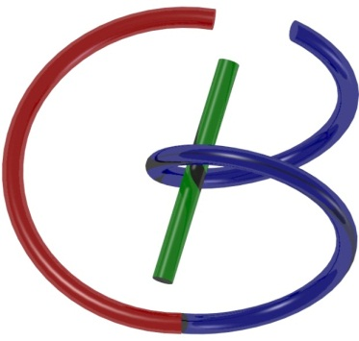

38655 BMED-2300-02
Lecture 17: SPECT & PET
Ge Wang, PhD
Biomedical Imaging Center
CBIS/BME, RPI
wangg6@rpi.edu
March 28, 2017

Slide 2
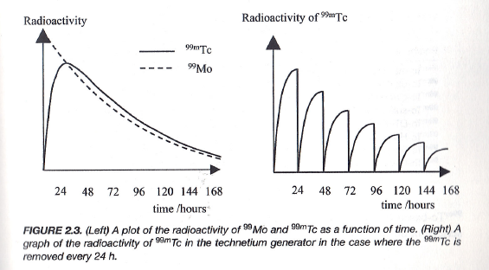
Daily Yield
The ratio of the two species is constant – the decay rate of the daughter is governed by the half-life of the parent.

Slide 3
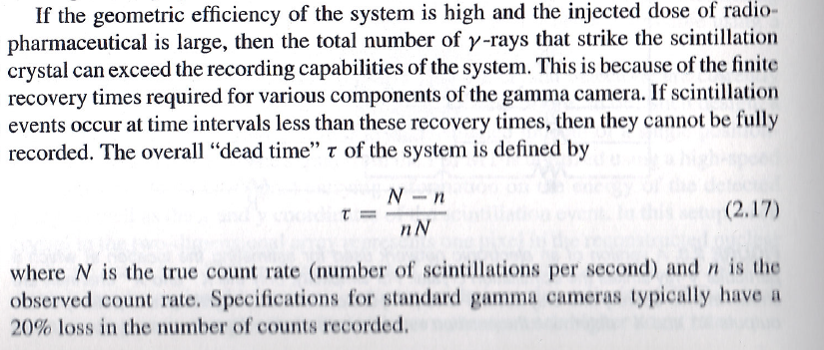
Dead Time
$$τ=\frac{1}{n}−\frac{1}{N}$$

Slide 4
SPECT & PET
Statistical Distributions
Data Modeling
Single Emission
Paired Emission
Reconstruction Methods
Attenuation Compensation
Deterministic Reconstruction
Statistical Reconstruction
SPECT & PET Scanners
Architectures
Scatter Correction
Fully3D
Conference & Community

Slide 5
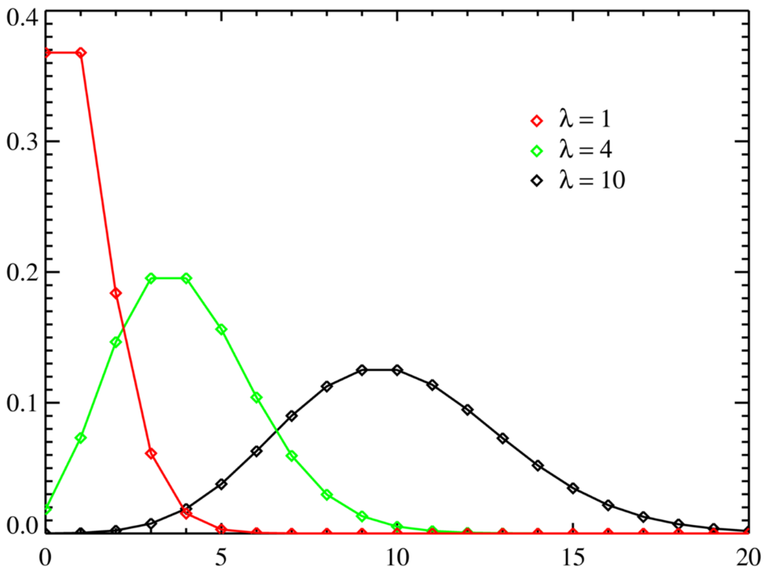
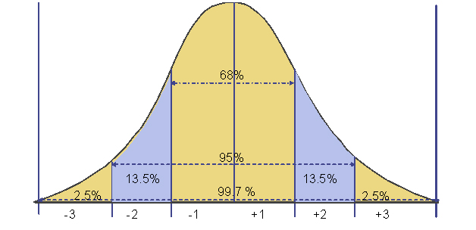
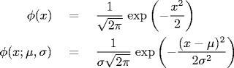
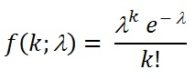
Gaussian & Poisson Noise

Slide 6
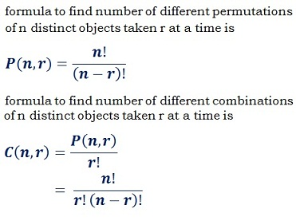
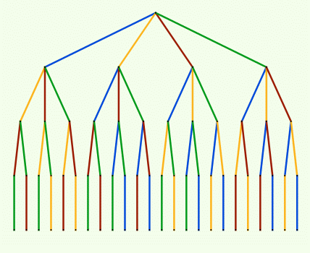
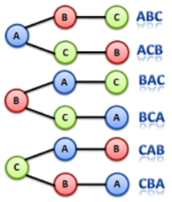
Combination Formula

Slide 7
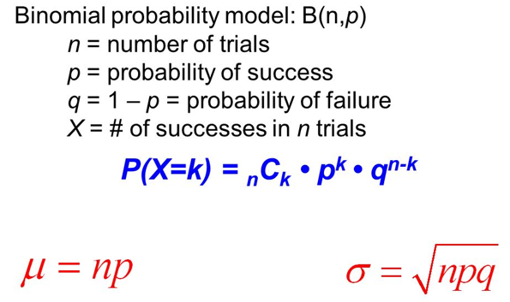

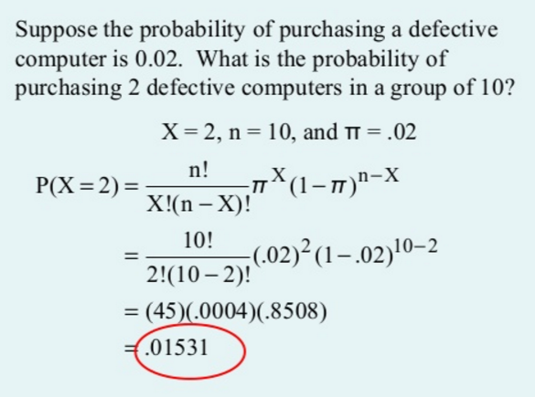
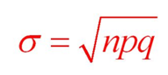

Binomial Formula
P(X=k) = C(n, k)

Slide 8
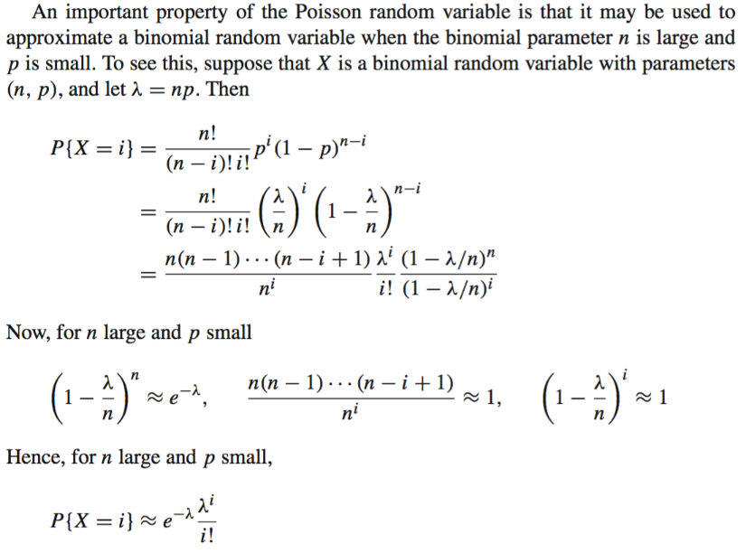
Poisson Distribution
Binomial formula
p=λ/n
In total, I factors in the 1st part
$$p_{r}(n)=\frac{e^{−r}r^{n}}{n!}$$
Expected Photons
Measured Photons

Slide 9
SPECT & PET
Statistical Distributions
Data Modeling
Single Emission
Paired Emission
Reconstruction Methods
Attenuation Compensation
Deterministic Reconstruction
Statistical Reconstruction
SPECT & PET Scanners
Architectures
Scatter Correction
Fully3D
Conference & Community

Slide 10

Data with & w/o Constant Weight
E ~ 60-600keV (e.g., E _{99mTc}=140keV)
Single Photon Emission:
Paired Photon Emission:
s=d
s=a
s
s=d₁
γ
γ
s=d₂
s=a
s
The above formulas are for the single source point, and the real signal is a sum/integral long the line of response (attenuated or conventional line integrals; see later slides)

Slide 11
Can Weight Be Source-position Independent for SPECT?
s=d₁
s=d₂
s=a
s
s=d₁
γ
γ
s=d₂
s=a
s

Slide 12
No, SPECT Model Is More Complicated!
s=d₁
s=d₂
s=a
s=b
s
The cross terms are messy, and hence the SPECT data model contains source-position-dependent weighting factors, even if you know the attenuation background.

Slide 13
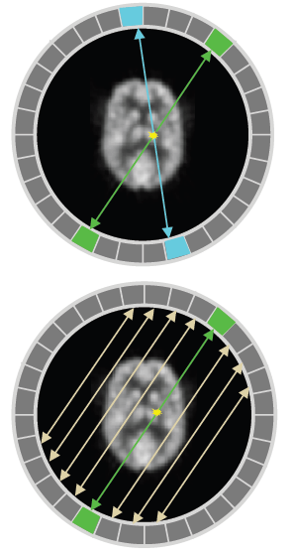
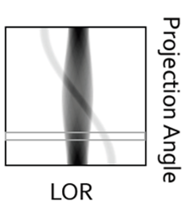
PET Sinogram
Emission Coincidence Detection
Group Data into Projection
Along Line of Response (LOR)
Sort LOR Data into a Sinogram
Projection

Slide 14
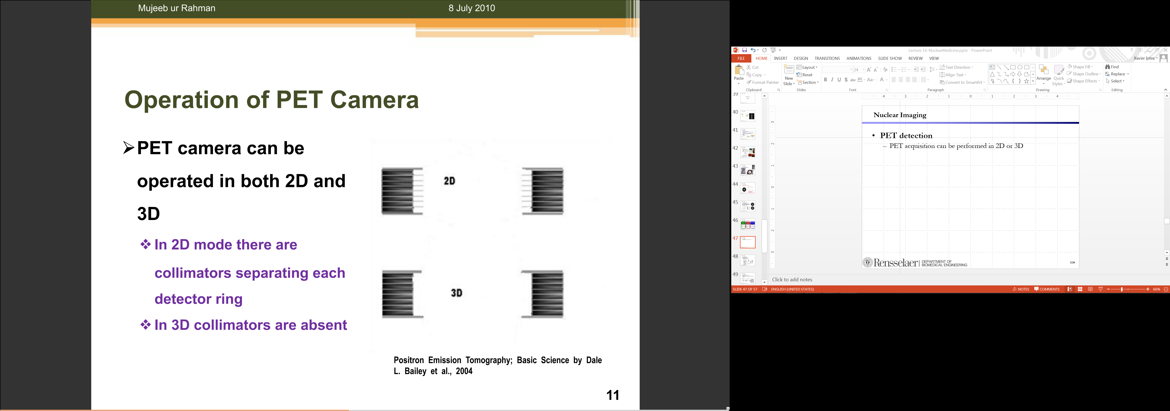
2D vs 3D PET
Mechanical Collimators Separating Detector Ring & Defining Imaging Planes
Mechanical Collimators Unavailable Relying on 3D Electronic Collimation

Slide 15
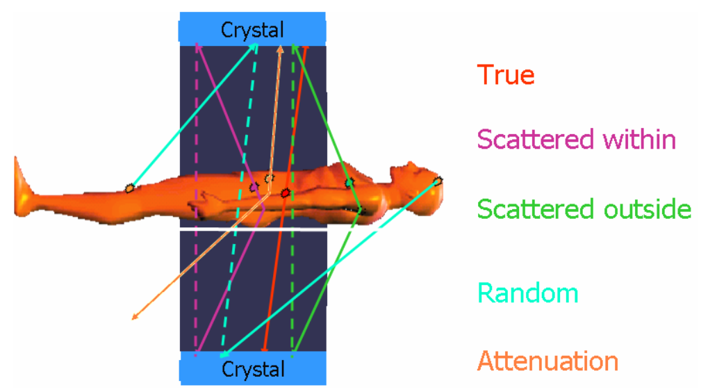
3D PET
Advantage:
Absence of Mechanical Collimators Increases Sensitivity
Drawback:
Wide Opening Increases Scattered & Random Events

Slide 16
SPECT & PET
Statistical Distributions
Data Modeling
Single Emission
Paired Emission
Reconstruction Methods
Attenuation Compensation
Deterministic Reconstruction
Statistical Reconstruction
SPECT & PET Scanners
Architectures
Scatter Correction
Fully3D
Conference & Community

Slide 17
Deterministic SPECT Recon
Detected Number of Photons
SPECT:
Radon Transform:
FBP Not Directly Applicable due to Attenuation!
Assuming No Attenuation
Assuming Constant Attenuation
Transmission Scan

Slide 18
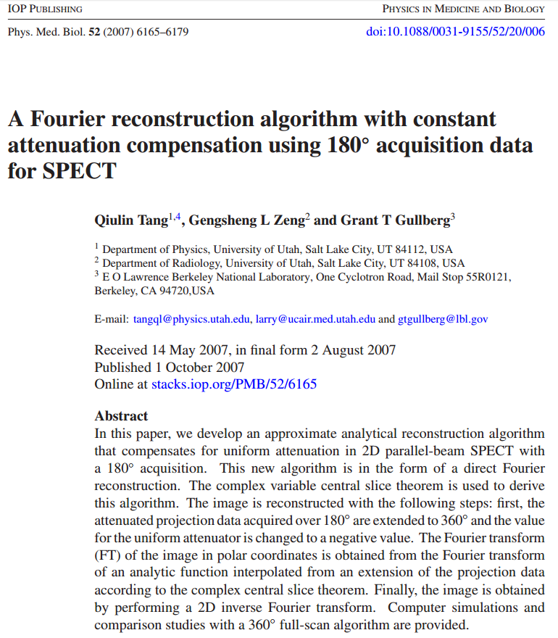
In Case of Curiosity

Slide 19
Deterministic PET Recon
Detected Number of Photons
PET:
Inverse Radon Transform
Not Directly Applicable!
Assuming Constant Attenuation
Transmission Scan
Time of Flight Estimation

Slide 20
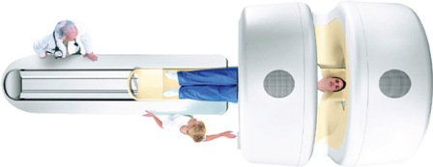
Attenuation Correction
Photon Energy in PET (511keV) Different from That in CT:
Spectrum Converted to the Effective Energy For Example: 140 kVp -> Effective Energy 70keV
Piecewise Linear Relationship between PET and CT
Bone
PET Attenuation (cm⁻¹)
Water
PET-CT: Not Only Registered Anatomy & Physiology But Also Attenuation Correction!
Air
CT Attenuation (cm⁻¹)

Slide 21
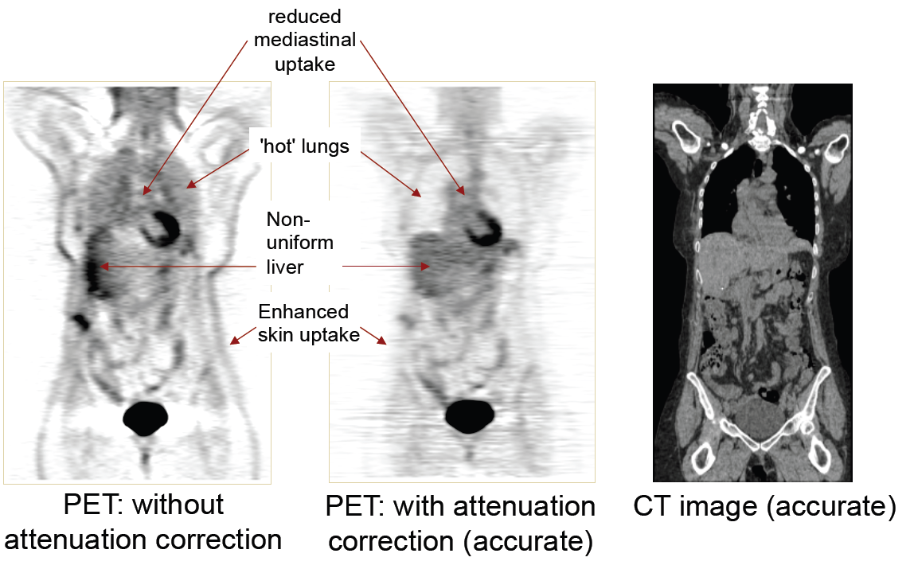
Attenuation Effect

Slide 22
Bayesian Approach
Denote Λ: Image to Be Estimated Q: Data Actually Measured
Bayes’ Rule:
Find the Maximum a-posteriori Probability (MAP)
If p(Λ) Constant (p(Q) Constant Anyway)
Then, the MAP Estimation Problem Becomes the Maximum Likelihood (ML) Estimation Problem

Slide 23
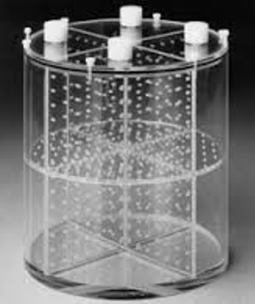
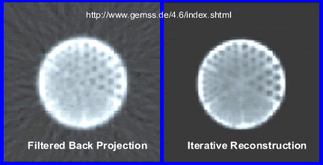



Phantom Reconstruction
FBP
iterative reconstruction

Slide 24
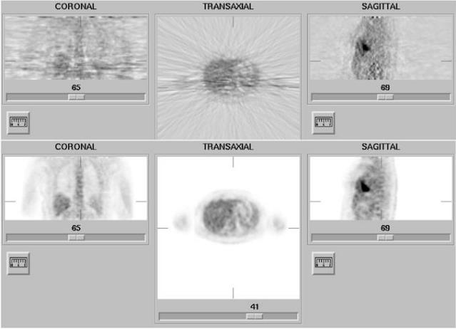
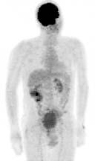
Patient Reconstruction
FBP
ML Iterative Recon
(34 iterations)

Slide 25
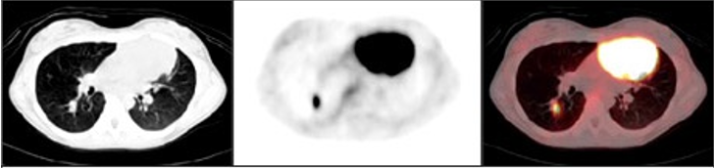
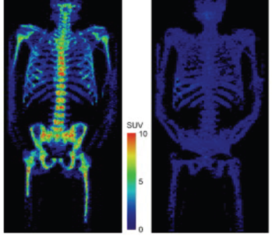
PET-CT

Slide 26
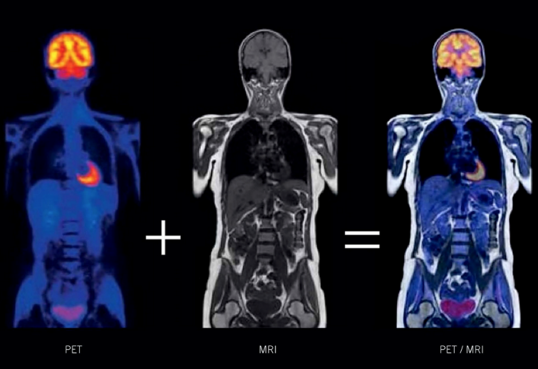
PET-MRI

Slide 27
SPECT & PET
Statistical Distributions
Data Modeling
Single Emission
Paired Emission
Reconstruction Methods
Attenuation Compensation
Deterministic Reconstruction
Statistical Reconstruction
SPECT & PET Scanners
Architectures
Scatter Correction
Fully3D
Conference & Community

Slide 28
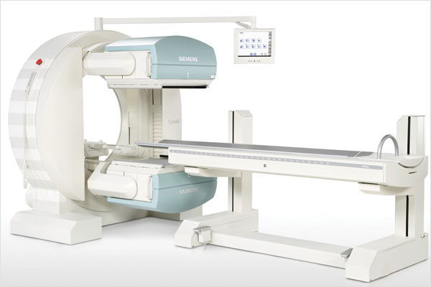
SPECT Scanner

Slide 29
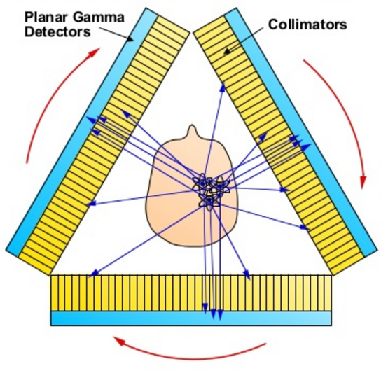
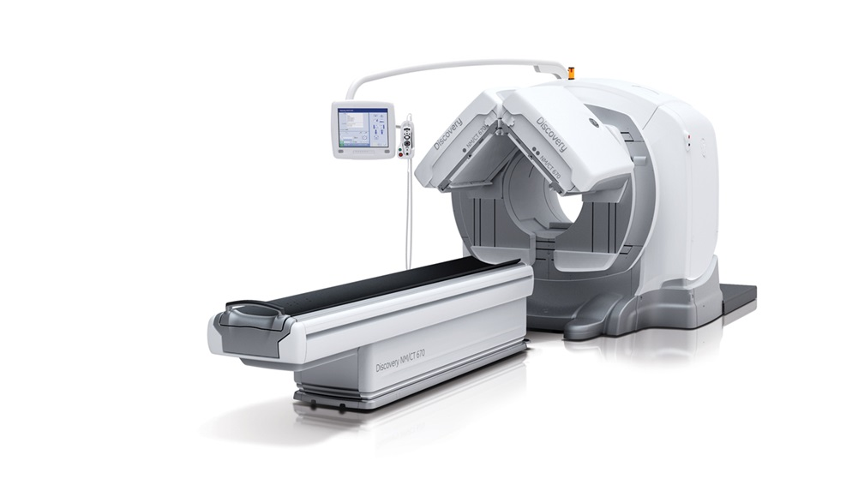
SPECT-CT

Slide 30
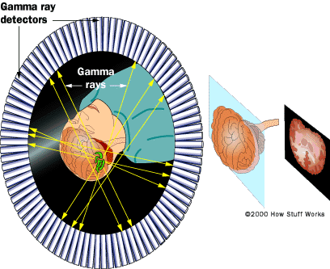
PET Ring

Slide 31
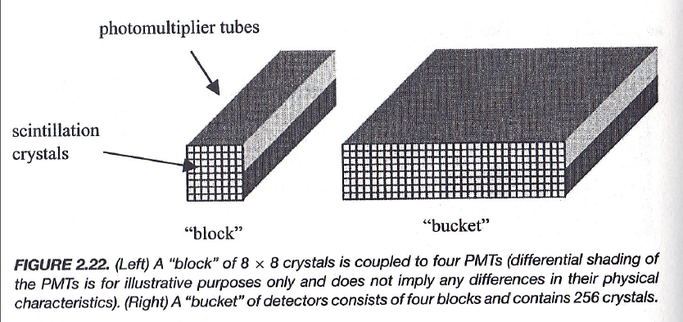
Block & Bucket

Slide 32
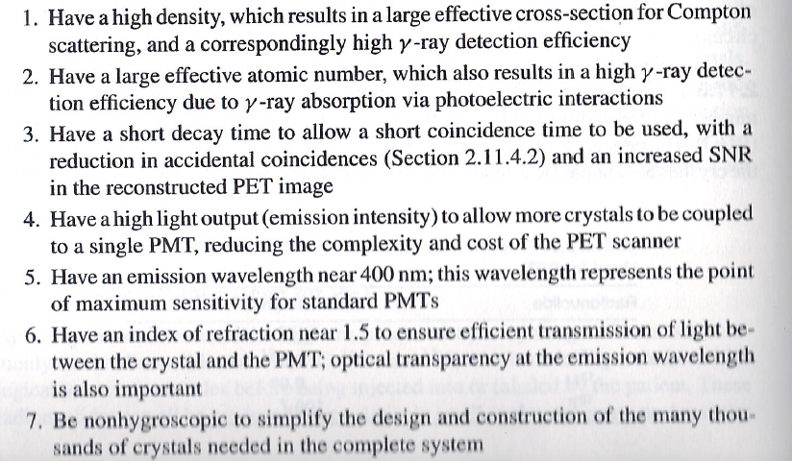
Desirable Properties

Slide 33
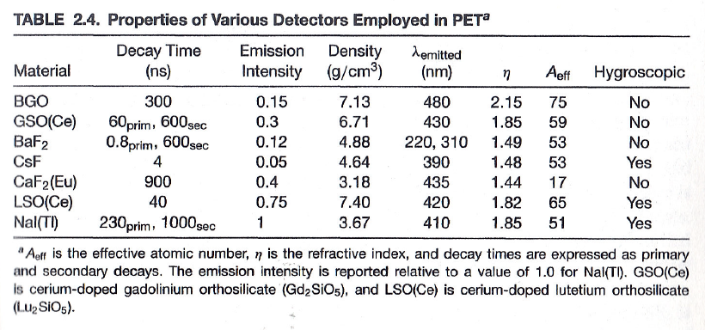
Detector Materials

Slide 34
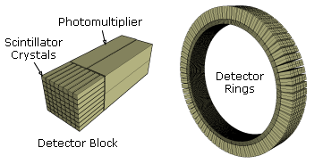
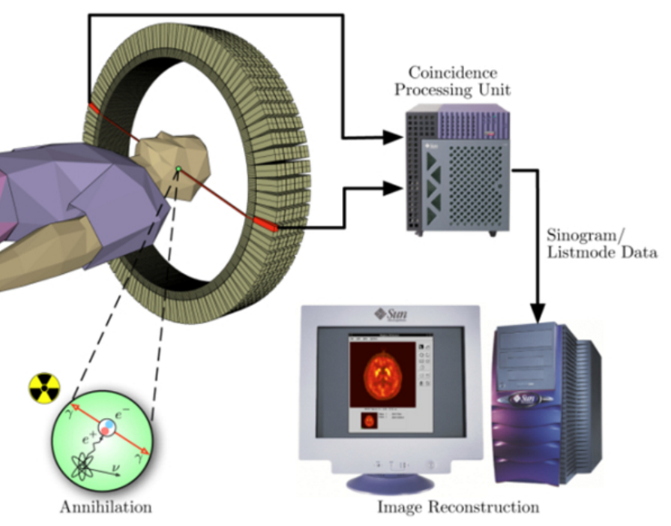
Key Component: PET Detector
Scintillator Blocks of Many Crystal Units
Multiple PMTs (4 on Right) Connected to Each Block
Incident 511kev Photons Make Visible Light
Visible Light Converted to Electrical Signal, Processed, & Recorded

Slide 35
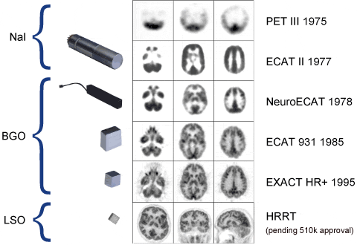
Significant Progress in Detector

Slide 36
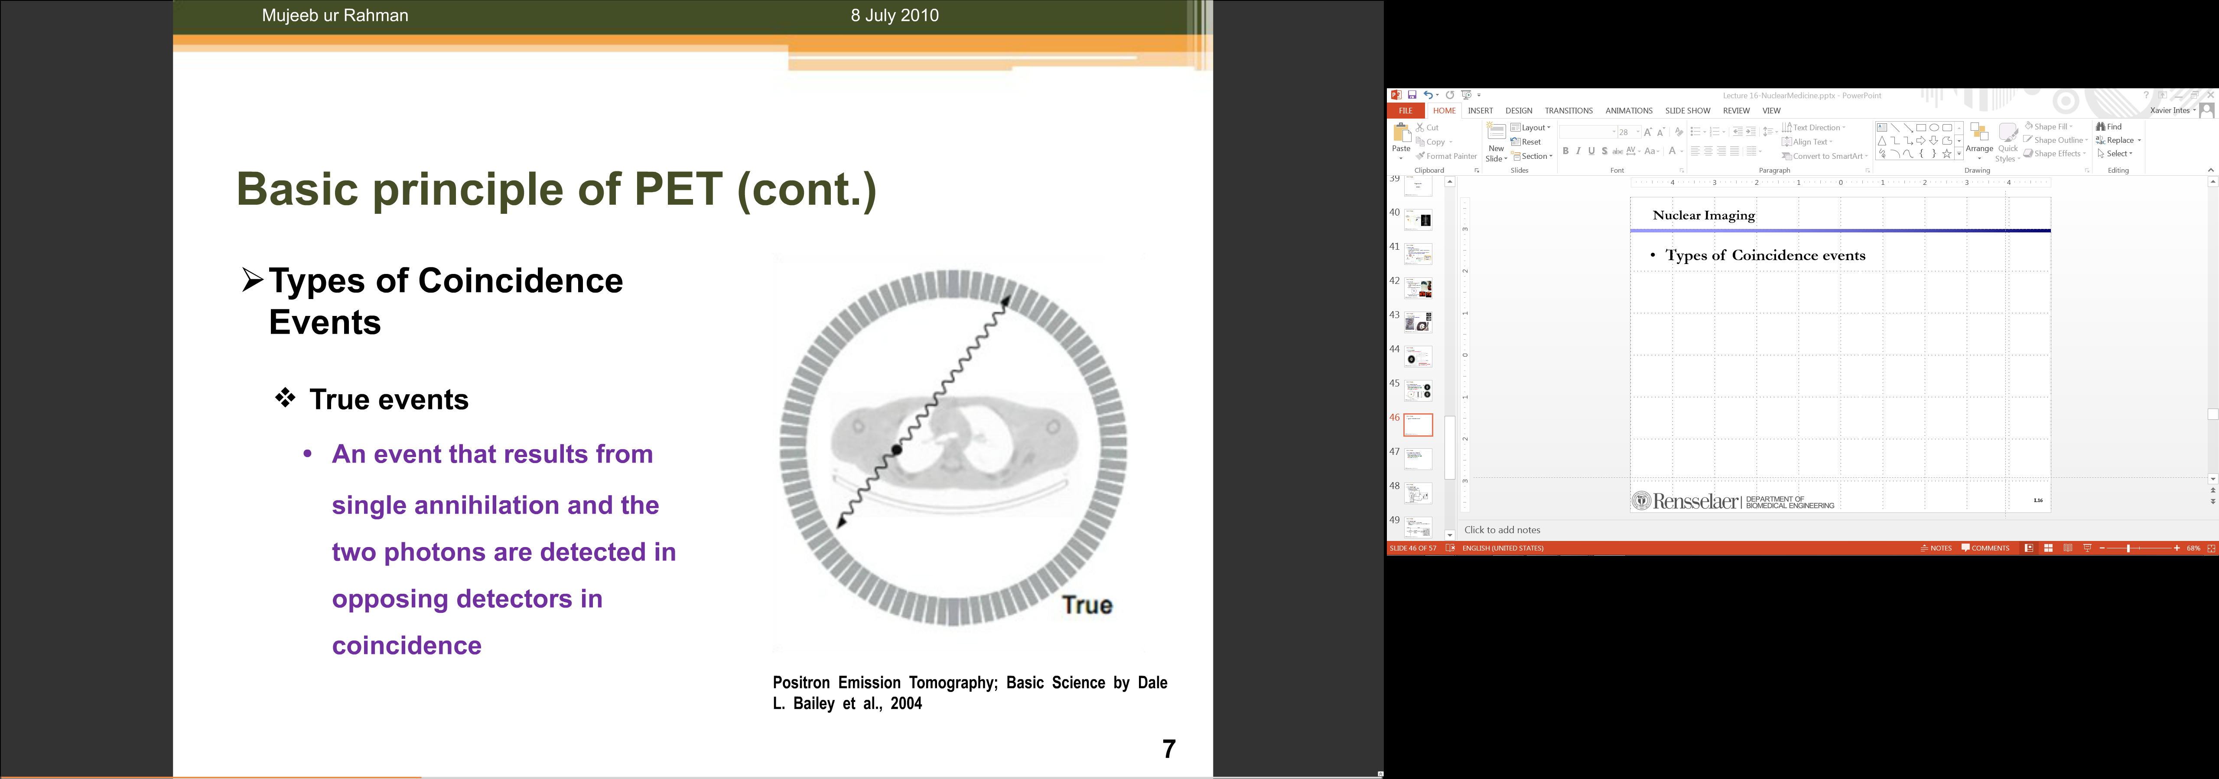
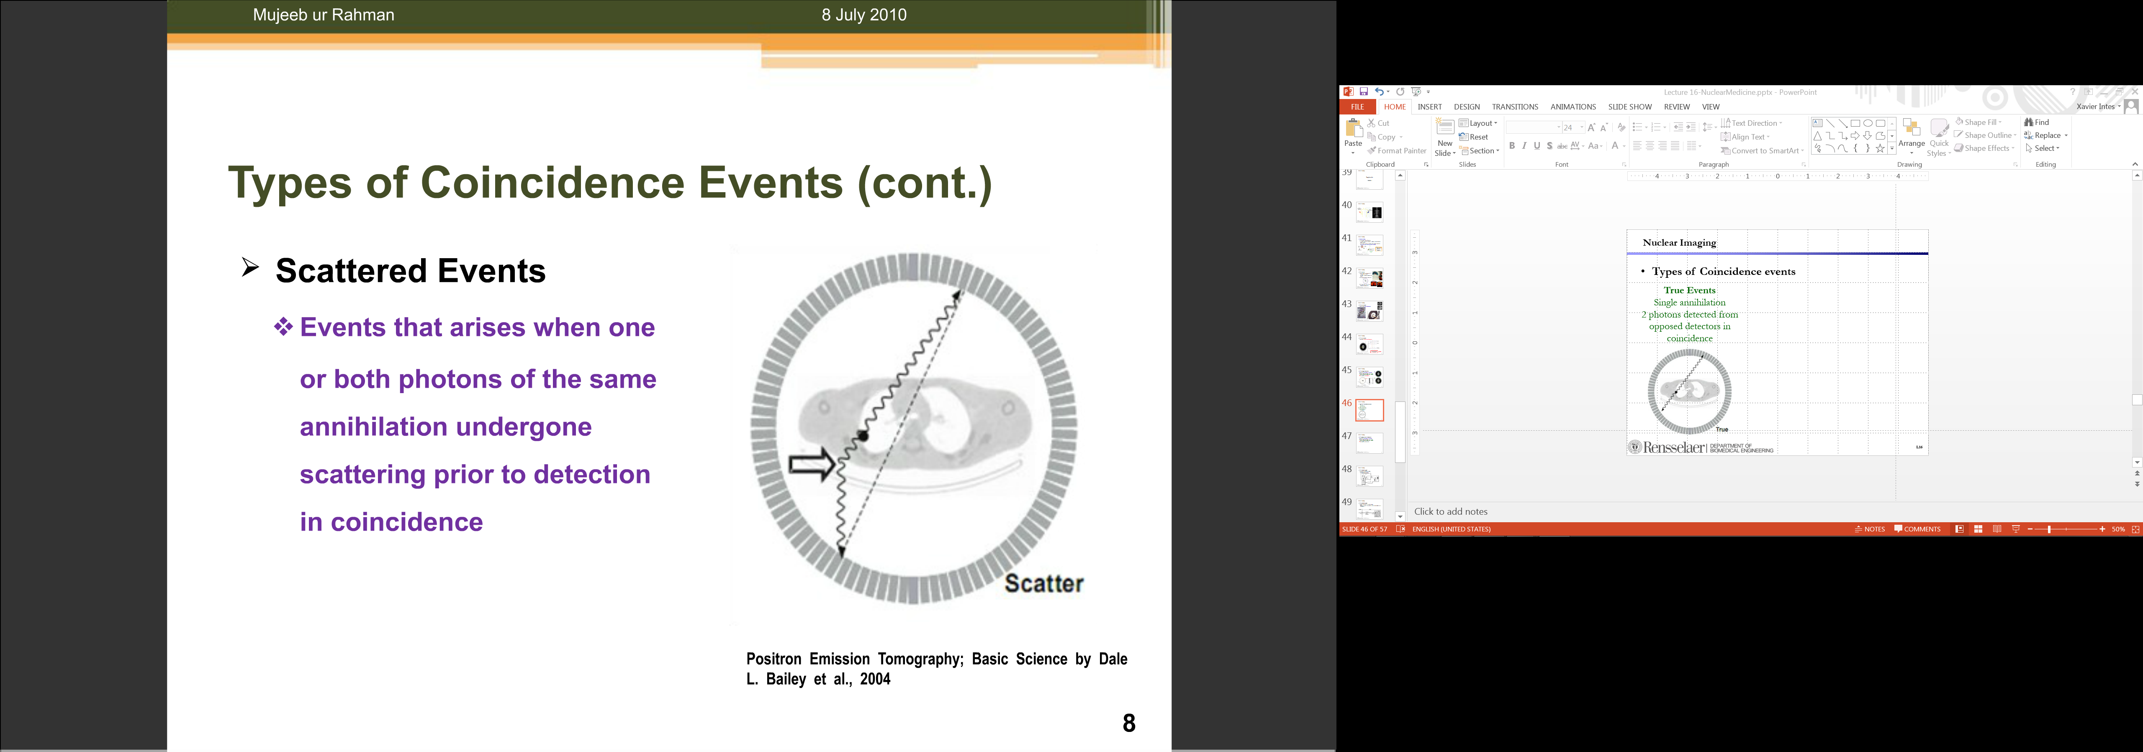
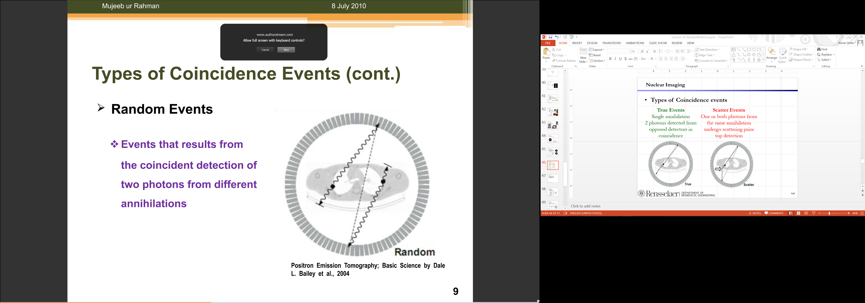
Types of Coincidence Events
True Events
Single Annihilation
Two Photons Detected from Opposite Detectors
Scatter Events
Photons from the Same Event Scattered prior to Coincidence Detection
Random Events
Coincidence of Two Photons from Different Events

Slide 37
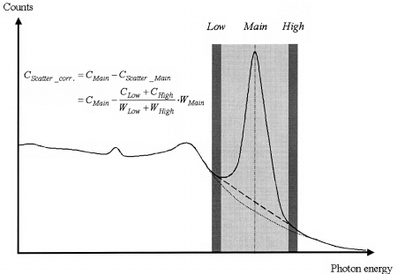
Tri-windows for Scatter Correction
https://www.researchgate.net/figure/7209769_fig1_Fig-1-Window-settings-in-Triple-Energy-Window-scatter-correction-The-main-window-is

Slide 38
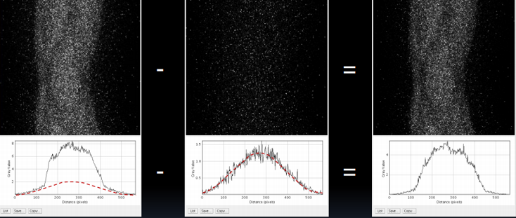
Scatter Correction

Slide 39
Random Correction
Multiple Photons Can Be Detected by Different Modules
(Time Accuracy ~ 10ns; Scintillation Time BGO ~300 ns)
Random Data Can Be Removed with a Delayed Window
(Number of Random Counts Independent of Delay)
Probability [(Single in d₁ at t*)∩(Single in d₂ at t*)] =
Probability [(Single in d₁ at t*+Δt)∩(Single in d₂ at t*)]
Delay
d₁
γ
Detection
d₂
γ

Slide 40
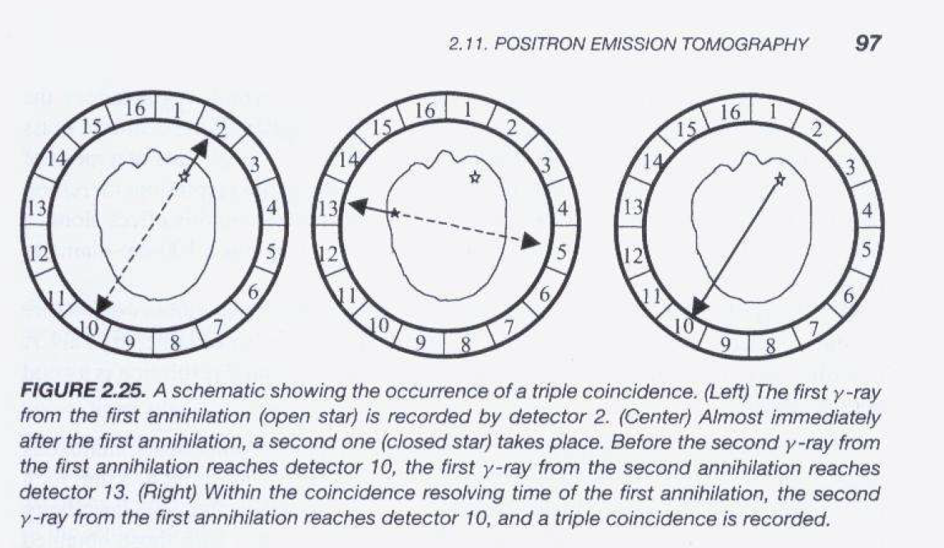
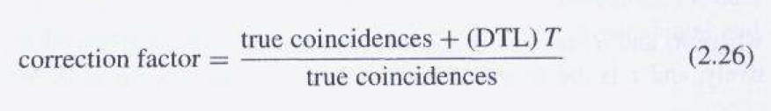

Slide 41
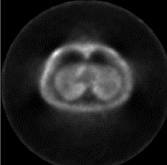
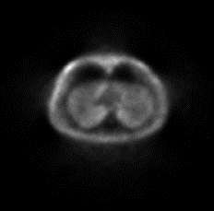
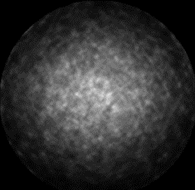
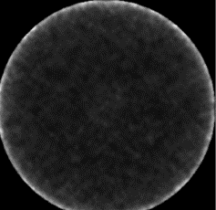
Correction Demo
Total Counts
True Counts
Scatter Counts
Random Counts

Slide 42
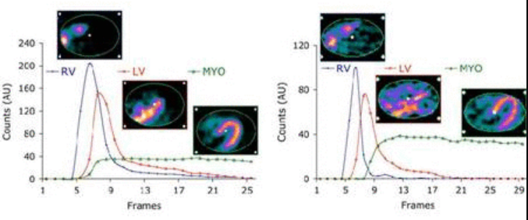
Quantitative PET
Attenuation Correction
Scatter & Random Correction
Dead Time Correction

Slide 43
Synchrony Allows Timing
SPECT – Mechanical Collimation
Many Photons Blocked
PET – Electronic Collimation No Absorption by High-Z Collimator
PET Sensitivity > SPECT Sensitivity
γ
γ
γ

Slide 44

Whole Body PET (Cherry Lab)

Slide 45

Whole Body SPECT/PET-CT?

Slide 46



Multiple Pin Holes?
Robert A. Vogel, Dennis Kirch, Michael LeFree, and Peter Steele: A New Method of Multiplanar Emission Tomography Using a Seven Pinhole Collimator and an Anger Scintillation Camera, J Nucl Med. 1978;19:648-654.

Slide 47
SPECT & PET
Statistical Distributions
Data Modeling
Single Emission
Paired Emission
Reconstruction Methods
Attenuation Compensation
Deterministic Reconstruction
Statistical Reconstruction
SPECT & PET Scanners
Architectures
Scatter Correction
Fully3D
Conference & Community

Slide 48



Slide 49

http://www.fully3d.org

Slide 50


Slide 51

Xi’an Bell Tower
Xi’an is the City of New York in the ancient world, with the Bell Tower in its center to synchronize life over dynasties…

Slide 52


Logo

Slide 53

Modalities
CT
Cone-beam Geometry
SPECT
Photomultiplier Tubes
Crystal
Collimator
Bow-tie Phantom
PET
Detector Ring

Slide 54

Variants

Slide 55

Animation

Slide 56

Fully3D Community

Slide 57


BB17 Homework
Due Date: Same (1 Working Week Later)

